Slide 1
Evolutionary Algorithms with A Simple Encoding Mechanism（编码机制） for Energy Optimization（能源优化） and Mobile Edge Computing（移动边缘计算）
Yong Wang
School of Automation
Central South University
ywang@csu.edu.cn
https://intleo.csu.edu.cn/

Slide 2
Outline
Evolutionary Algorithms and Encoding
I: A Simple Encoding Mechanism and Its Application in Wind Farm Layout
II: A Simple Encoding Mechanism and Its Application in Multi-UAV Enabled Mobile Edge Computing
III: A Simple Encoding Mechanism and Its Application in a UAV-Assisted IoT Data Collection System
IV: A Simple Encoding Mechanism and Its Application in Blockchain
Conclusion
2

Slide 3
Outline
Evolutionary Algorithms and Encoding
I: A Simple Encoding Mechanism and Its Application in Wind Farm Layout
II: A Simple Encoding Mechanism and Its Application in Multi-UAV Enabled Mobile Edge Computing
III: A Simple Encoding Mechanism and Its Application in a UAV-Assisted IoT Data Collection System
IV: A Simple Encoding Mechanism and Its Application in Blockchain
Conclusion
3

Slide 4
Encoding (1/6)
In evolutionary algorithms (EAs), a population（群体） includes several individuals（个体）.
What does each individual represent?
  A solution（解）
How to design an individual
  Encoding（编码）

Slide 5
Encoding (2/6)
Binary encoding（二进制编码）
Representative（代表性的） EAs: GA
Representative applications: feature selection（特征选择）, knapsack problems（背包问题）, etc.
string position
(locus)
string
(chromosome)
1 | 2 | 3 | 4 | 5 | 6 | 7 | 8 | 9 | 10 | 11 | 12 | 13 | 14
0 | 0 | 1 | 1 | 1 | 0 | 1 | 0 | 1 | 1 | 1 | 0 | 1 | 0
An individual
feature,
(gene)
feature value
(allele)
14 bits & 14 binary digits

Slide 6
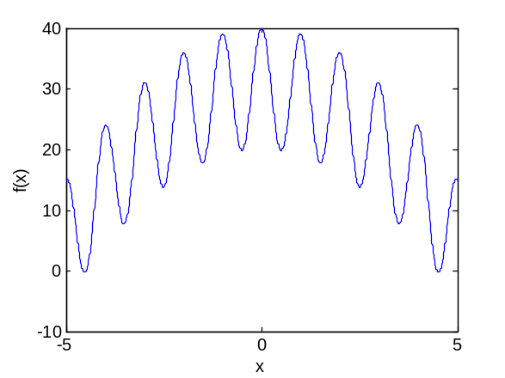
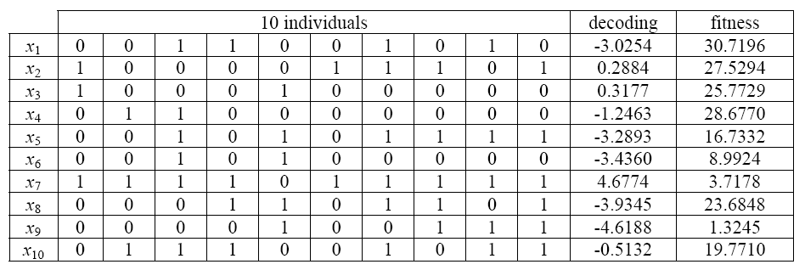
Encoding (3/6)
An issue in binary encoding — decoding（解码）
An example

Slide 7
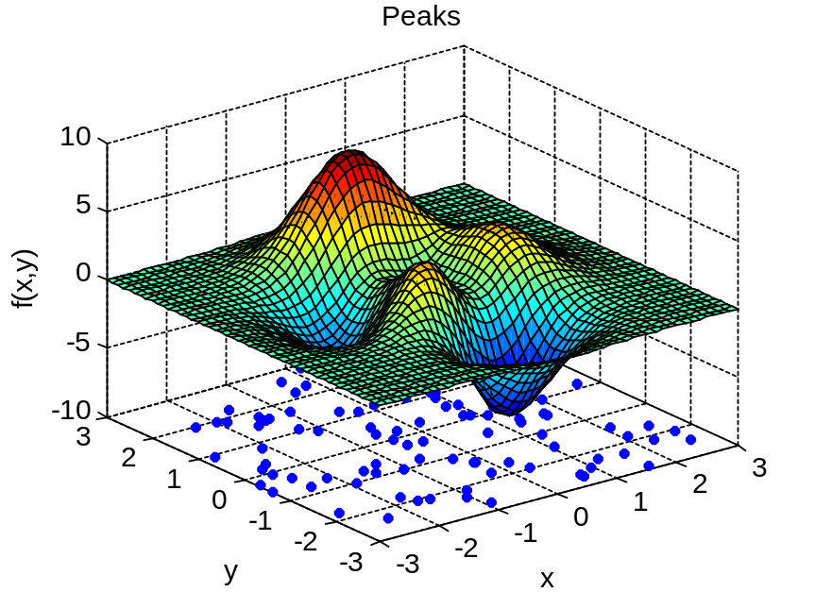
Encoding (4/6)
Real-coded encoding（实数编码）
(-1.2, 2.3)
Representative（代表性的） EAs: ES, EP, PSO, DE, etc
Representative applications: real-value optimization problems（实值优化问题）
An individual

Slide 8
Encoding (5/6)
Order encoding（序列编码）
Representative（代表性的） EAs: ACO
Representative applications: TSP（旅行商问题）, scheduling problems（调度问题）
2
1
2
2
1→2→3→4
An individual
5
4
7
3
4
1

Slide 9
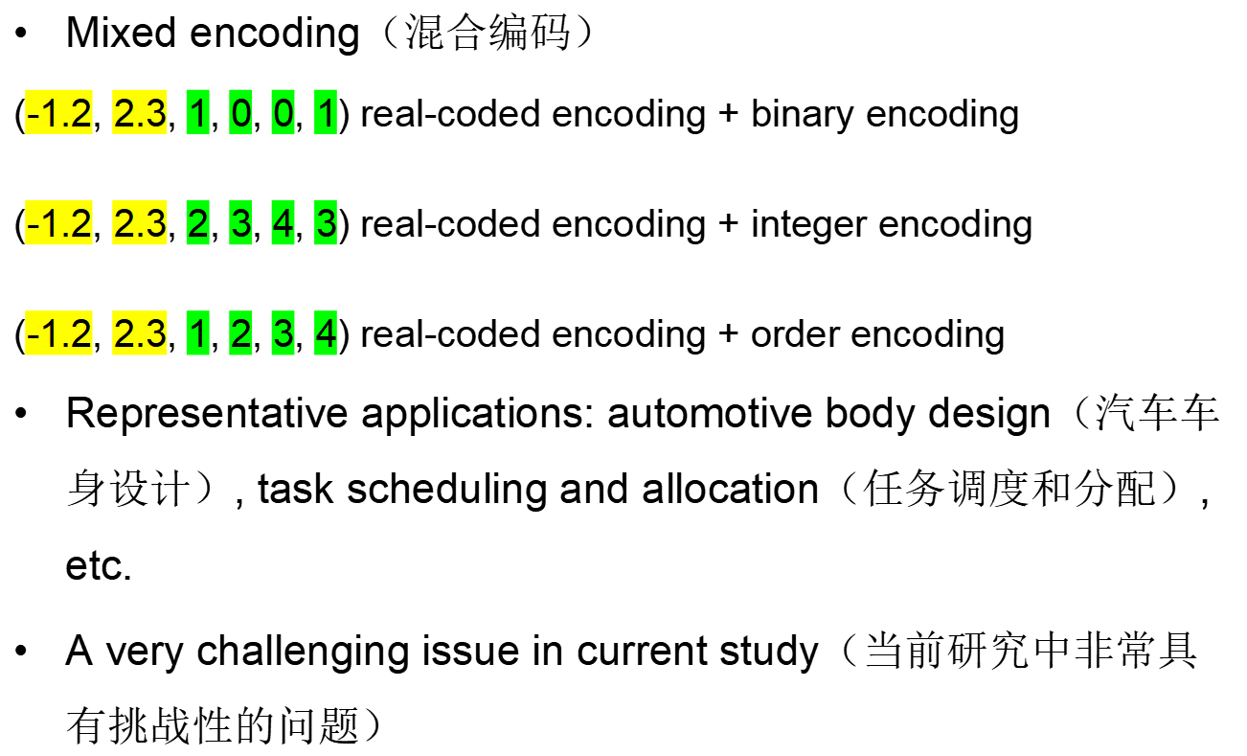
Encoding (6/6)
An individual
An individual
An individual

Slide 10
Outline
Evolutionary Algorithms and Encoding
I: A Simple Encoding Mechanism and Its Application in Wind Farm Layout
II: A Simple Encoding Mechanism and Its Application in Multi-UAV Enabled Mobile Edge Computing
III: A Simple Encoding Mechanism and Its Application in a UAV-Assisted IoT Data Collection System
IV: A Simple Encoding Mechanism and Its Application in Blockchain
Conclusion

Slide 11
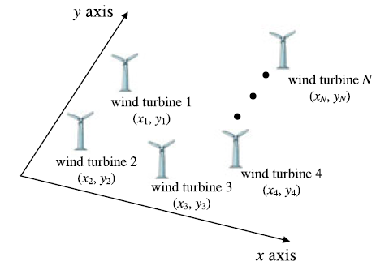

Wind Farm Layout (风电场布局，1/2)

Slide 12
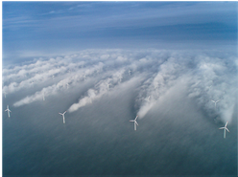
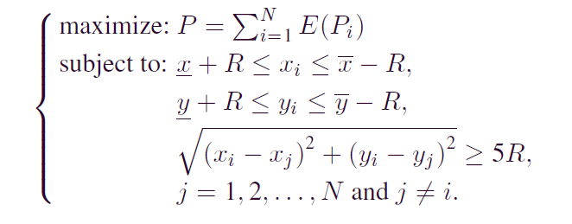
Wind Farm Layout (2/2)
Model（模型）
Wake Effect
（尾流效应）
Objective（目标）: find the optimal layout of all the wind turbines（风机） to
maximize the power output（风能输出） of a wind farm
Constraints（约束条件）: a wind turbine should lie within the wind farm;
the distance between wind turbine i and any other
wind turbine should not be shorter than 5R

Slide 13



Related Work (1/2)
Greedy methods（贪婪方法）
  Only one layout is considered and only one wind turbine in the layout is moved by some strategies（策略） similar to random search（随机搜索） or local search（局部搜索） in each iteration.
  The evaluation of the layout can be sped up（加速） by utilizing the caching technique.
  Drawback: poor global search ability（全局搜索能力弱）

Slide 14
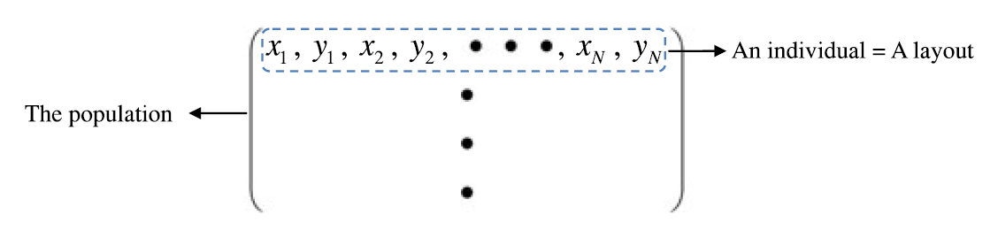
Related Work (2/2)
EAs（进化算法）
  Each individual usually represents an entire（完整的） layout and each dimension of an individual denotes a coordinate（坐标） of a wind turbine.
  After implementing evolutionary operators（进化算子） on the individuals, maybe many wind turbines rather than just one wind turbine are updated. It is hard to use the caching technique to accelerate（加速） the evaluation of a layout under this condition.
  Drawback: a great deal of computational time（计算时间高）

Slide 15
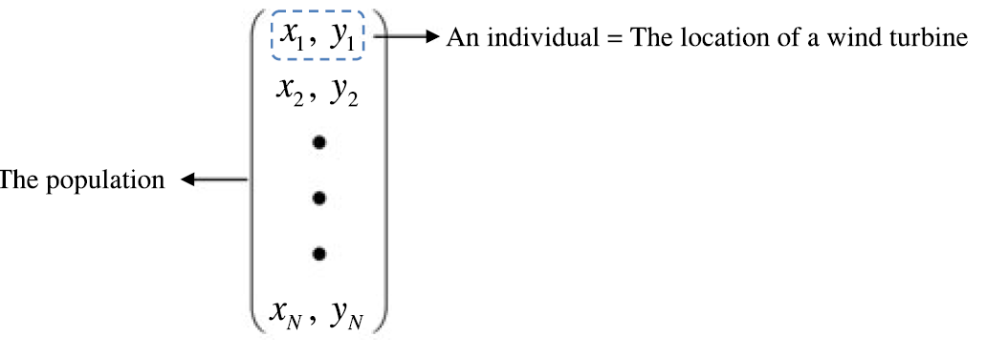
A Simple Encoding Mechanism (1/2)
Motivation（动机）
  It is clear that the location of a wind turbine is determined by a 2-D coordinate system（坐标系） (i.e., x-axis and y-axis) and each dimension of all the wind turbines has the same search region（搜索范围）.
Y. Wang, H. Liu, H. Long, Z. Zhang, and S. Yang. Differential evolution with a new encoding mechanism for optimizing wind farm layout. IEEE Transactions on Industrial Informatics, vol. 14, no. 3, pp. 1040-1054, 2018.

Slide 16
A Simple Encoding Mechanism (2/2)
Advantages（优势）
  A population represents a layout. Under this condition, if only one wind turbine (i.e., one individual) is moved in each iteration, the caching technique can be applied.
  Each individual can be updated by evolutionary operators. In this manner, the global search ability can be strengthened（加强）.
  The population size does not need to be predefined（预先定义） since it is equal to the number of wind turbines.
Therefore, the advantages of greedy methods and EAs can be combined effectively by this encoding mechanism.

Slide 17
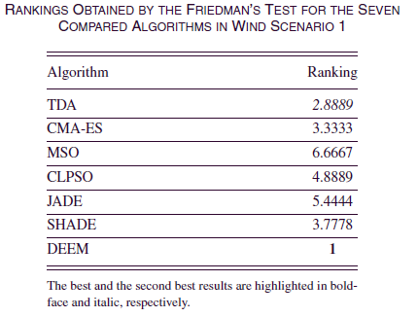
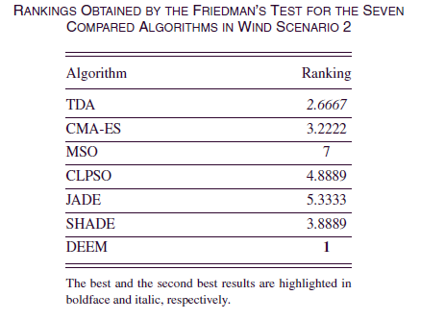
Experimental Results (1/3)

Slide 18
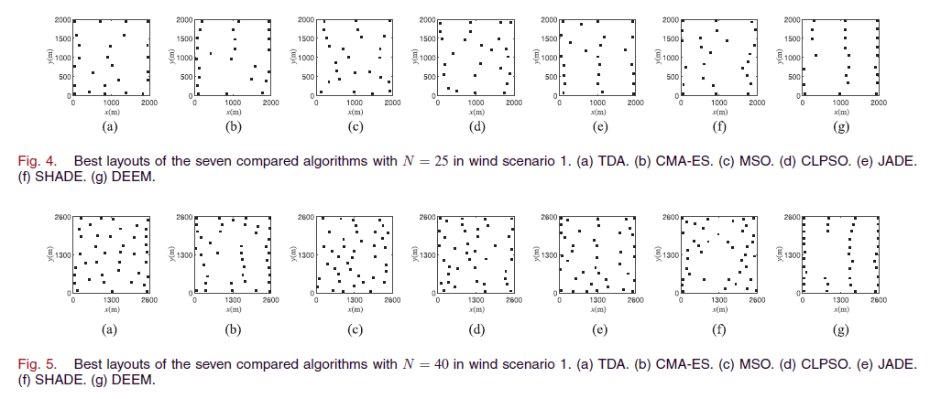
Experimental Results (2/3)

Slide 19
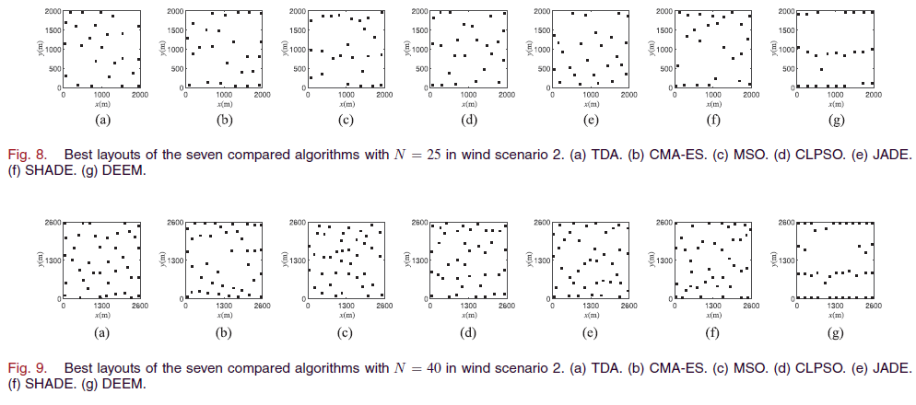
Experimental Results (3/3)

Slide 20
Outline
Evolutionary Algorithms and Encoding
I: A Simple Encoding Mechanism and Its Application in Wind Farm Layout
II: A Simple Encoding Mechanism and Its Application in Multi-UAV Enabled Mobile Edge Computing
III: A Simple Encoding Mechanism and Its Application in a UAV-Assisted IoT Data Collection System
IV: A Simple Encoding Mechanism and Its Application in Blockchain
Conclusion

Slide 21
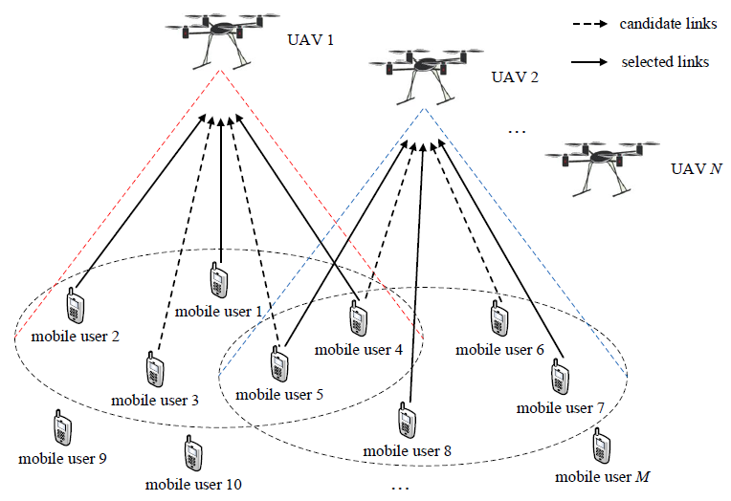
Multi-UAV Enabled Mobile Edge Computing（移动边缘计算）
Task 1: deployment（配置） of UAVs
the number（数量） and locations（位置） of UAVs
Task 2: task scheduling（任务调度）
whether a task is executed locally（本地的） or on a UAV and how many resources should be allocated（分配）

Slide 22

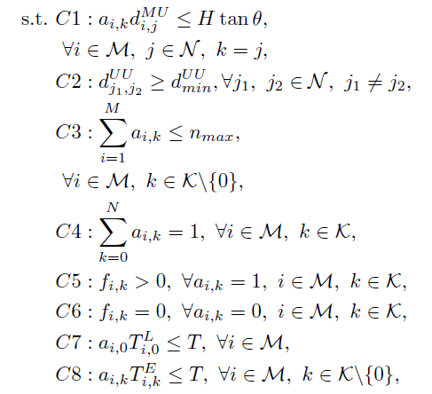
Model（模型）
Objective（目标）: jointly optimize（联合优化） the deployment of UAVs and the task scheduling to minimize the system energy consumption（能量消耗）

Slide 23
Challenges（挑战）
We need to optimize the number of UAVs (N), the locations of UAVs, the offloading decisions（卸载决策）, and the resource allocation for M mobile users. It is evident that the number of decision variables increases with the increase of M and/or N.
It includes an integer decision variable（整数决策变量）, continuous decision variables（连续决策变量）, and binary decision variables（二进制决策变量）. Thus, it is an optimization problem with mixed decision variables.
Actually, the deployment of UAVs and the task scheduling are closely coupled（耦合） with each other.

Slide 24
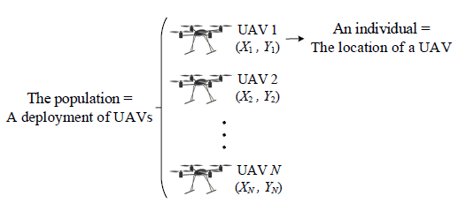
A Simple Encoding Mechanism (1/3)
Motivation
  Each UAV has two decision variables (i.e., X_{j} and Y_{j} in the x-axis and y-axis), and all elements in {X₁,…,X_{N}} have the same upper and lower bounds, as well as all elements in {Y₁,…,Y_{N}}.
Y. Wang, Z.-Y. Ru, K. Wang, and P.-Q. Huang. Joint deployment and task scheduling optimization for large-scale mobile users in multi-UAV enabled mobile edge computing. IEEE Transactions on Cybernetics, vol. 50, no. 9, pp. 3984-3997, 2020.

Slide 25
A Simple Encoding Mechanism (2/3)
Advantages
  Each individual has a fixed（固定的） length during the evolution, rather than a variable（变化的） length.
  The length of each individual is equal to two, which means the deployment of UAVs is optimized in a very low-dimensional（低维的） search space, i.e., two.

Slide 26
A Simple Encoding Mechanism (3/3)
How to adjust（调整） the population size
  After analysing this system, to achieve the minimum energy consumption, we should give a priority（优先） to the number of UAVs under the condition that all tasks can be completed.
  Based on this property, we first determine the maximum number of UAVs, and gradually reduce the number if all tasks can be completed.
  In principle, the number of UAVs is adaptively （自适应）adjusted.

Slide 27
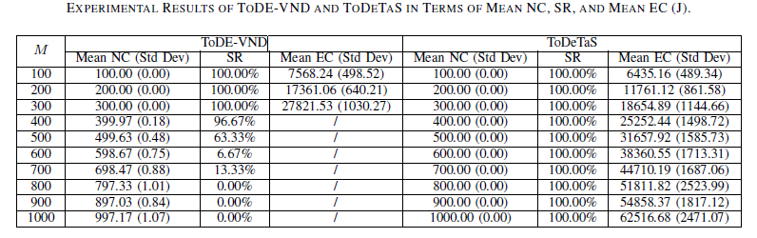
Experimental Results (实验结果，1/2)

Slide 28
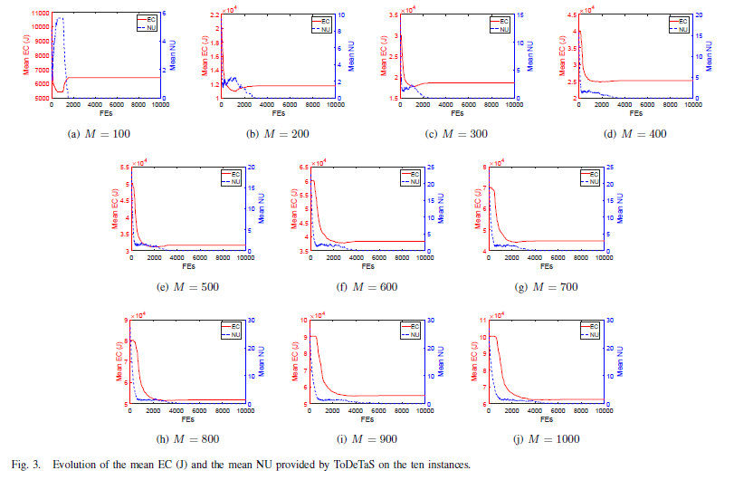
Experimental Results (2/2)

Slide 29
Outline
Evolutionary Algorithms and Encoding
I: A Simple Encoding Mechanism and Its Application in Wind Farm Layout
II: A Simple Encoding Mechanism and Its Application in Multi-UAV Enabled Mobile Edge Computing
III: A Simple Encoding Mechanism and Its Application in a UAV-Assisted IoT Data Collection System
IV: A Simple Encoding Mechanism and Its Application in Blockchain
Conclusion

Slide 30
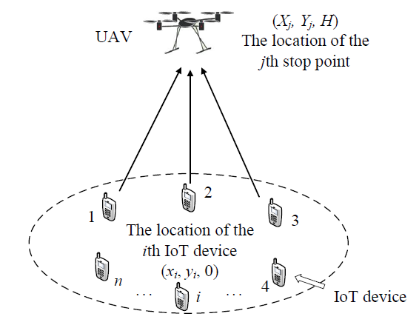
A UAV-Assisted IoT Data Collection System（物联网数据收集系统）
A UAV is employed as a data collection platform（收集平台） for a group of ground（地面的） IoT devices

Slide 31
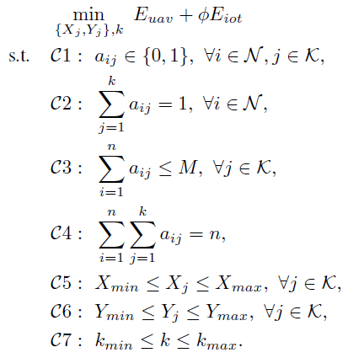
Model
Objective: optimize the UAV deployment（配置）, including the number and locations of stop points（停靠点） of the UAV to minimize the energy consumption of the system which is composed of the energy consumption of the UAV and all IoT devices.

Slide 32
Challenges
When using evolutionary algorithms to solve this deployment problem, each individual usually represents an entire deployment（完整的配置）.
Due to the fact that the number of stop points is unknown a priori, the length of each individual in the population should be varied during the optimization process.
As a result, the commonly used（通常使用的） mutation and crossover operators cannot be used directly.

Slide 33
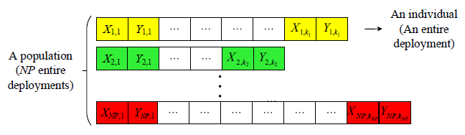
Related Work (1/2)
The approaches（方法） with special mutation and crossover operators
  Each individual in the population represents an entire deployment, which consists of the locations of a set of stop points. Then, the population represents NP entire deployments.
  The special mutation and crossover operators need to be adopted.
  Drawback: the dimension of the search space may change from generation to generation for each individual, thus causing confused（混乱的） search.

Slide 34
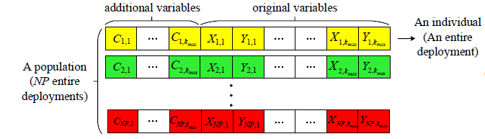
Related Work (2/2)
The approaches with additional（额外的） variables
  The individual and the population are also encoded into an entire deployment and NP entire deployments, respectively.
  The length of each individual in the population is 3kmax, consisting of kmax additional variables (i.e., C_{i},₁,…,C_{i},_{kmax}) and 2kmax original variables (i.e., X_{i},₁, Y_{i},₁,…,X_{i},_{kmax,}Y_{i},_{kmax}).
  Drawback: the length of each individual will drastically increase due to the introduction of additional variables, thus leading to a high-dimensional search space.

Slide 35
A Simple Encoding Mechanism (1/4)
Motivation
  Although the number of stop points that the UAV needs to visit is variable during the evolution, the dimension of the location of each stop point is fixed.
  Since the flying height H of the UAV is a constant（固定） in this case, the dimension of the location of each stop point can be considered as two (i.e., the x-axis and y-axis). Moreover, the values of the locations of all stop points in the x-axis and y-axis have the same upper and lower bounds.

Slide 36
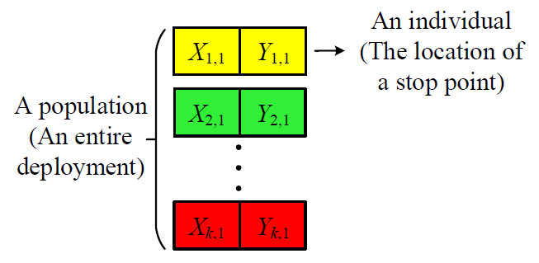
A Simple Encoding Mechanism (2/4)
The location of each stop point is encoded into an individual.
The whole（整个） population represents an entire deployment.
The population size is equal to the number of stop points.
P.-Q. Huang, Y. Wang*, K. Wang, and K. Yang. Differential evolution with a variable population size for deployment optimization in a UAV-assisted IoT data collection system. IEEE Transactions on Emerging Topics in Computational Intelligence, vol. 4, no. 1, pp. 324-335, 2020.

Slide 37
A Simple Encoding Mechanism (3/4)
Advantages
  The population size is equal to the number of stop points, which is optimized during the evolution. Therefore, this parameter has been eliminated（淘汰）.
  The length of each individual in the proposed encoding mechanism is always fixed. In this manner, the special mutation and crossover operators are not required.
  Compared with the approaches with additional variables, the length of each individual in the population is equal to two. Consequently, the dimension of the search space is remarkably reduced.

Slide 38
A Simple Encoding Mechanism (4/4)
How to adjust the population size
  We design a strategy to adjust the population size according to the performance improvement. By this strategy, the number of stop points can be increased, reduced, or kept unchanged adaptively.

Slide 39
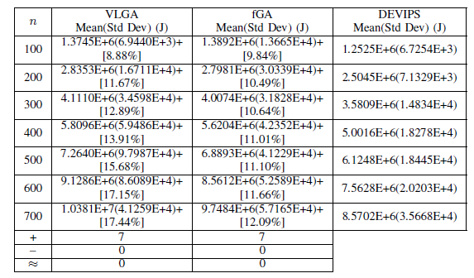
Experimental Results (1/4)
Comparison with two approaches with special mutation and crossover operators (VLGA and fGA)

Slide 40
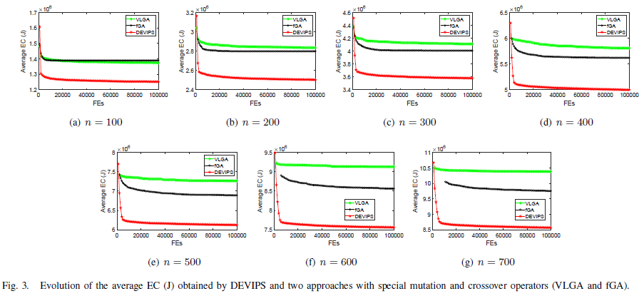
Experimental Results (2/4)

Slide 41
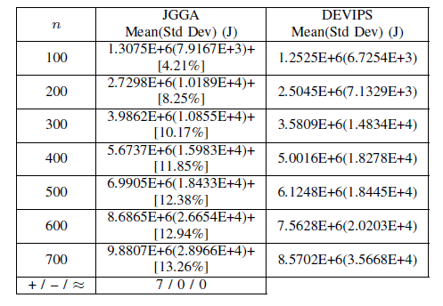
Experimental Results (3/4)
Comparison with an approach with auxiliary variables (JGGA)

Slide 42
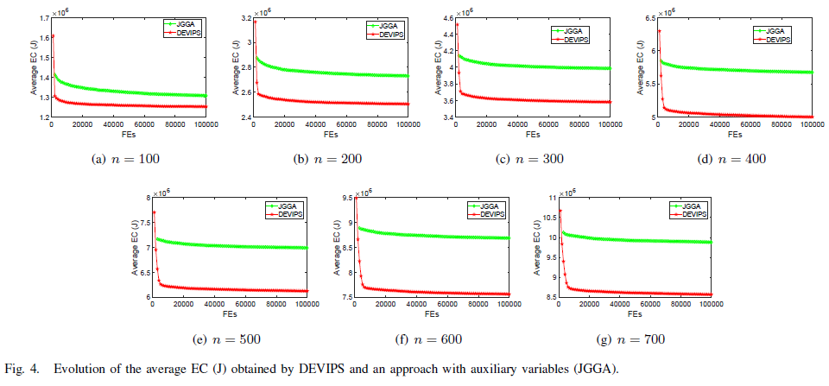
Experimental Results (4/4)

Slide 43
Outline
Evolutionary Algorithms and Encoding
I: A Simple Encoding Mechanism and Its Application in Wind Farm Layout
II: A Simple Encoding Mechanism and Its Application in Multi-UAV Enabled Mobile Edge Computing
III: A Simple Encoding Mechanism and Its Application in a UAV-Assisted IoT Data Collection System
IV: A Simple Encoding Mechanism and Its Application in Blockchain
Conclusion

Slide 44
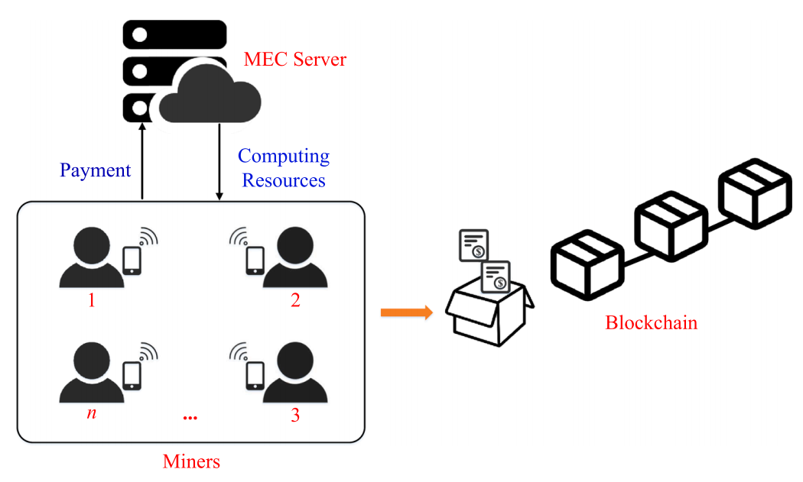
Blockchain（区块链）
Edge computing assists the mobile blockchain network to offload mining tasks

Slide 45
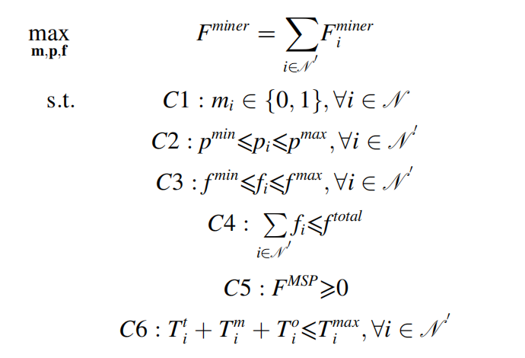
Model
Objective: jointly optimize mining decision（挖矿决策）, transmission power（传输功率）, and computing resource（计算资源） to maximize the profit（利润） of miners（矿工）

Slide 46
Challenges
The mining decision is a binary variable, and the transmission power and the computing resource are continuous variables. Thus, it is an optimization problem with mixed variables.
Although the search space is large, the complex constraints make the feasible region small.

Slide 47
Related Work (1/2)
EAs
  An individual represents the mining decisions, the transmission power, and the computing resources of all miners.
  If a miner decides not to participate in mining, this miner does not need to transmit its mining task to the MEC server or purchase computing resources to execute its mining task. In this case, the resource allocation for this non-participating miner is not required.
  Therefore, the commonly used encoding scheme generates the redundant（冗余的） search space, which may cause performance degradation.

Slide 48
Related Work (2/2)
EAs
computing resource
Mining
decision
resource allocation
x₁ | x₂ | x₃ | x₄ | p₁ | p₂ | p₃ | p₄ | f₁ | f₂ | f₃ | f₄
transmission power
An individual
1 | 0 | 1 | 0 | p₁ | p₂ | p₃ | p₄ | f₁ | f₂ | f₃ | f₄
ineffective values
（无效值）
redundant（冗余的） search space

Slide 49
A Simple Encoding Mechanism (1/3)
  Motivation
  Each individual represents the transmission power and the computing resource of one miner who chooses to offload.
  Thus, it provides a natural way to eliminate redundant information for miners who choose not to offload and to avoid optimizing mixed variables.
Y. Wang, C. Chen, P.-Q. Huang, and K. Wang. A new differential evolution algorithm for joint mining decision and resource allocation in a MEC-enabled wireless blockchain network. Computers & Industrial Engineering, vol. 155, Article 107186, 2021.

Slide 50
A Simple Encoding Mechanism (2/3)
The transmission power and the computing resource of one miner who chooses to participate in mining are encoded into an individual.
An individual
(resource allocation of one participating miner)
p₁ | f₁
p₂ | f₂
… | …
p_{n’} | f_{n’}
A population
(resource allocations of all participating miners)

Slide 51
A Simple Encoding Mechanism (3/3)
Advantages
  The encoding mechanism can remove redundant search space.
  It transforms the mixed variable optimization problem into a continuous optimization problem.
  The population size is equal to the number of participating miners in the proposed encoding scheme. Therefore, this parameter does not need to be preset.

Slide 52
Outline
Evolutionary Algorithms and Encoding
I: A Simple Encoding Mechanism and Its Application in Wind Farm Layout
II: A Simple Encoding Mechanism and Its Application in Multi-UAV Enabled Mobile Edge Computing
III: A Simple Encoding Mechanism and Its Application in a UAV-Assisted IoT Data Collection System
IV: A Simple Encoding Mechanism and Its Application in Blockchain
Conclusion

Slide 53
Conclusion
By analyzing the domain knowledge（领域知识） in real-world applications, we design a simple yet effective encoding mechanism in EAs.
In principle, this encoding mechanism reduces the dimension of the search space into two and eliminates an important parameter in EAs, i.e., the population size.
In essence, this encoding mechanism is able to alleviate（缓解） the issues caused by variable-length（变长度） optimization problems and mixed-variable（混合变量） optimization problems.

Slide 54


